Slide 1
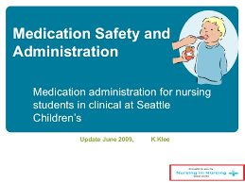

Slide 2
Introduction
The safety of both nurses and their patients is a crucial issue and should not be underestimated.
Bureau for labor statistics had in 2013 indicated a total prevalence rate of 6.4 work-related injuries and diseases among healthcare professionals
From Barnsteiner (2011), nursing students need to get access to knowledge and skills about the safe work environment for their patients.

Slide 3
Introduction
Cronenwett et al., (2007), defines safety in health as minimizing the risk of harm to patients and providers through a system of both effectiveness and individual performance; however, to be able to achieve this, it is understood that the provision of a safe and healthy work environment for nurses would ensure that nurses perform to the best of their abilities.

Slide 4


Slide 5
Objectives
It is important to understand that of all the members of the healthcare system, nurses are considered to play critically important roles in ensuring that they monitor closely the safety of their patients.
This course, therefore, has a single objective; to impart the much-needed knowledge to the nurse students about the care and management of the patients under their care.

Slide 6
Teaching strategies
Bastable (2017), states that teaching of nursing students requires active learning strategies that engage the students actively while learning.
These teaching strategies may include; role-play, divide some of the students to act as nurses while others as patients while others like family members.
Other activities may include; compare and contrast mechanism for students to create two similar case studies involving patients with similar disease symptoms.

Slide 7
What students to know about safe work environment for nurses?
Traditionally education for healthcare professionals has always focused on the care of the patients; however, this strategy always lacks the understanding of the complexity of care delivery systems.
Evidence-based research studies have indicated that teamwork and collaboration among healthcare professionals also assist them to work together to achieve a safe practice.

Slide 8
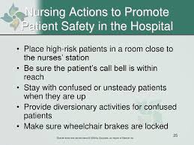

Slide 9
Activities that promote safety
For nursing students, the following categories have been identified to provide opportunities that ensure patient safety;
Incorporating user-centered designs
Avoiding reliance on memory
Attention to work safety
Design for recovery
Improving access to accurate and timely information.

Slide 10
Incorporating user-centered designs
This is based on mechanisms such as visibility, constraint and forcing functions.
Affordance and visibility are simple mechanisms that every student nurse should be well acquainted with to ensure that operations such as surgery are carried out without errors.

Slide 11
Avoiding reliance on memory
It is important to make the students aware that standardizing and simplifying medical procedures reduces the overreliance on human memory.
They should put in place the use of protocols and checklists to successfully reduce the reliance on human memory and be well informed about the use of default medication orders for the issuance of medicines.

Slide 12
Attention to work safety
It has been noted that distractions and interruptions of nurses affect the way they do things and a major cause of medication administration errors.
Nurses should, therefore, be educated oh how to ensure they avert such distractions and interruptions while in the course of duties.

Slide 13
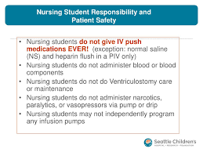

Slide 14
Design for recovery
Designing recovery mechanisms will act to ensure that reversible errors are reversed.
It is vital to note that the occurrence of errors is always accompanied by high levels of stress and a subsequent effect on the level of problem-solving skills, planning and teaching of the nursing students on the design recovery measures would, therefore, promote the practice of rescue.

Slide 15
Improving access to accurate and timely information
The information regarding drug formularies, patient records, medication, and administrative records needs to be available for the nurses, the teaching of the safety in the nurses' work environments would, therefore, ensure that nurses are well aware of the importance of having this information at the point of care.

Slide 16
Summary of the teaching plan
Throughout this unit, the students would be required to understand the dynamics around the workplace safety for nurses.
The phase would involve them in learning concerning patients’ safety and how to ensure safety is maintained.
The objectives would seek to ensure the students fully understand and consequently become aware of the importance of their workplace safety.

Slide 17

Nursing students

Slide 18


Slide 19
References
Barnsteiner, J. (2011). Teaching the culture of safety. The Online Journal of Issues in Nursing, 16(3).
Bastable, S. B. (2017). Nurse as educator: Principles of teaching and learning for nursing practice. Jones & Bartlett Learning.
Billings, D. M., & Halstead, J. A. (2015). Teaching in nursing-e-book: A guide for faculty. Elsevier Health Sciences.
Cronenwett, L., Sherwood, G., Barnsteiner, J., Disch, J., Johnson, J., Mitchell, P., ... & Warren, J. (2007). Quality and safety education for nurses. Nursing Outlook, 55(3), 122-131.

